Slide 1
Meeting 24/08
Joren Janzing

Slide 2
Content
Isopycnal slopes
Freshwater fluxes
1940s event
Correlation Maps
Surface FW flux
Baroclinic 1 month running mean.
New geometry

Slide 3
Isopycnal Slopes

Slide 4
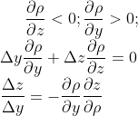
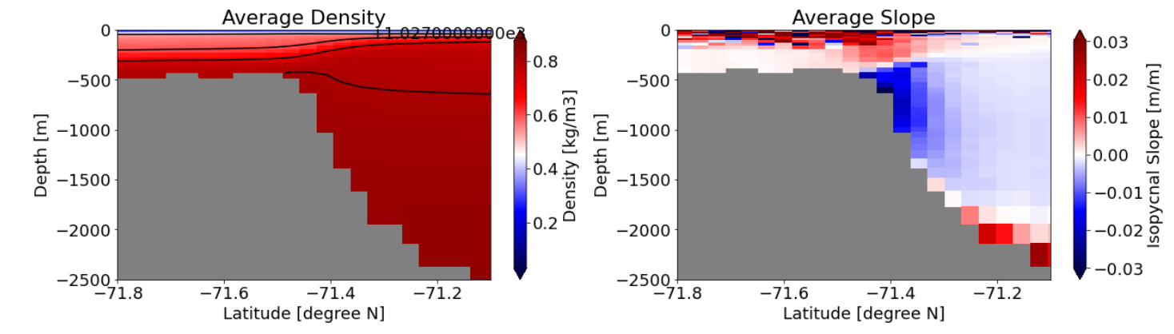
Light
Heavy

Slide 5
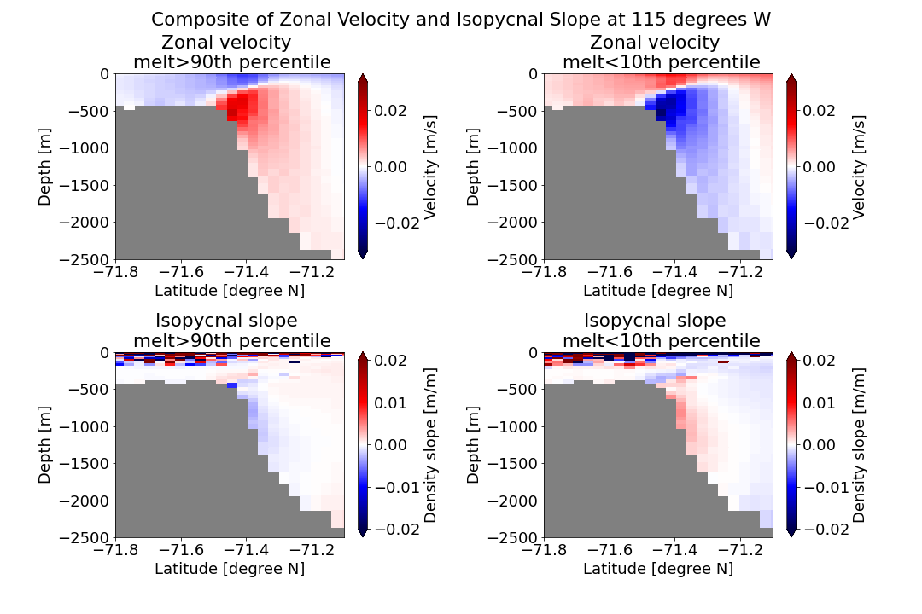

Slide 6
Freshwater fluxes

Slide 7
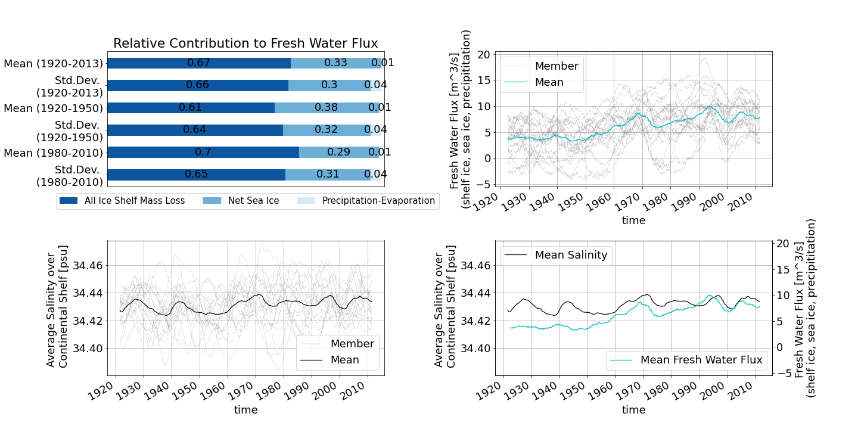

Slide 8
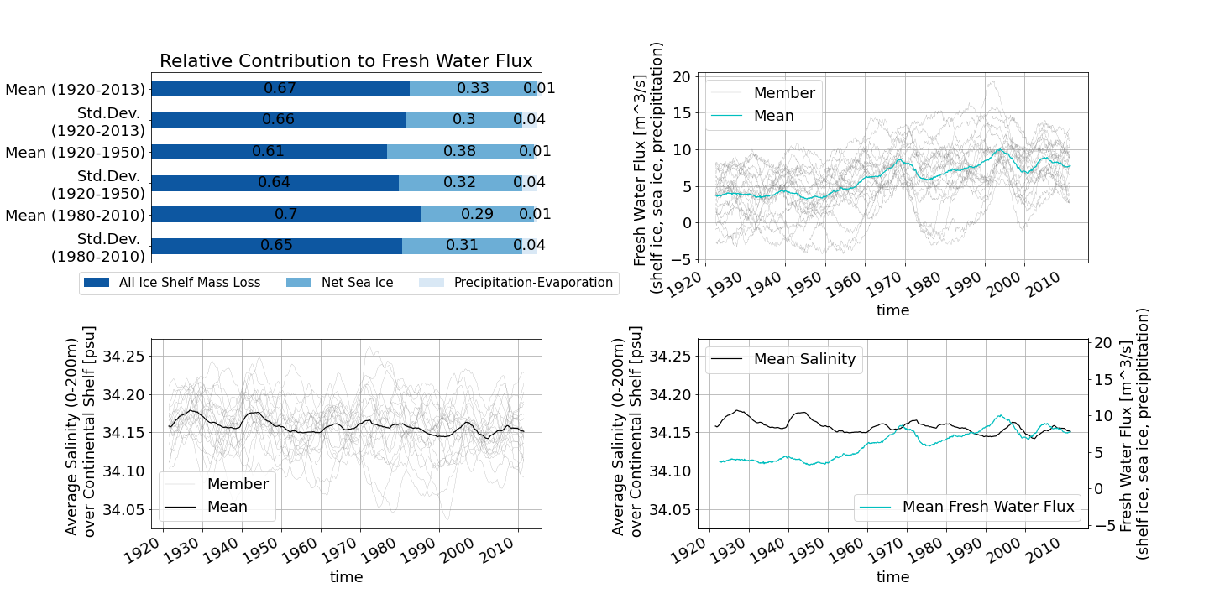

Slide 9
1940s event

Slide 10
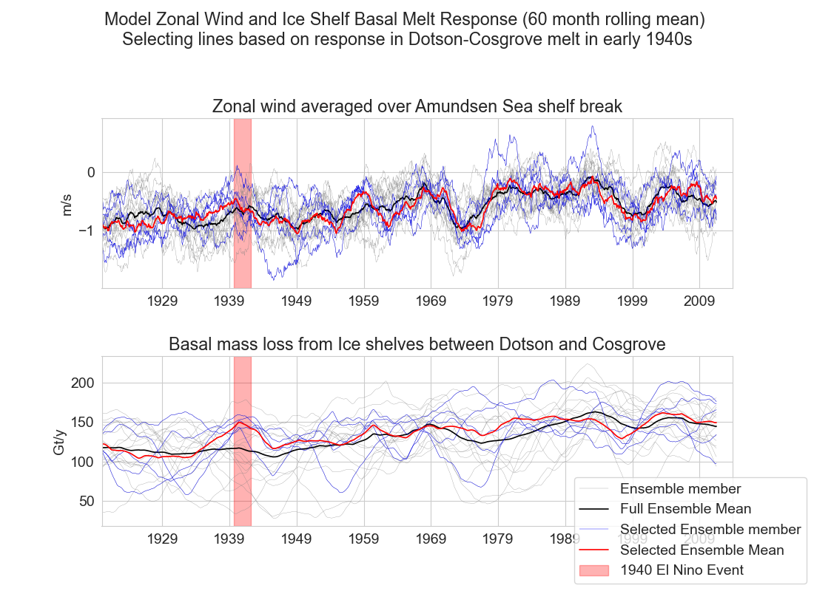

Slide 11
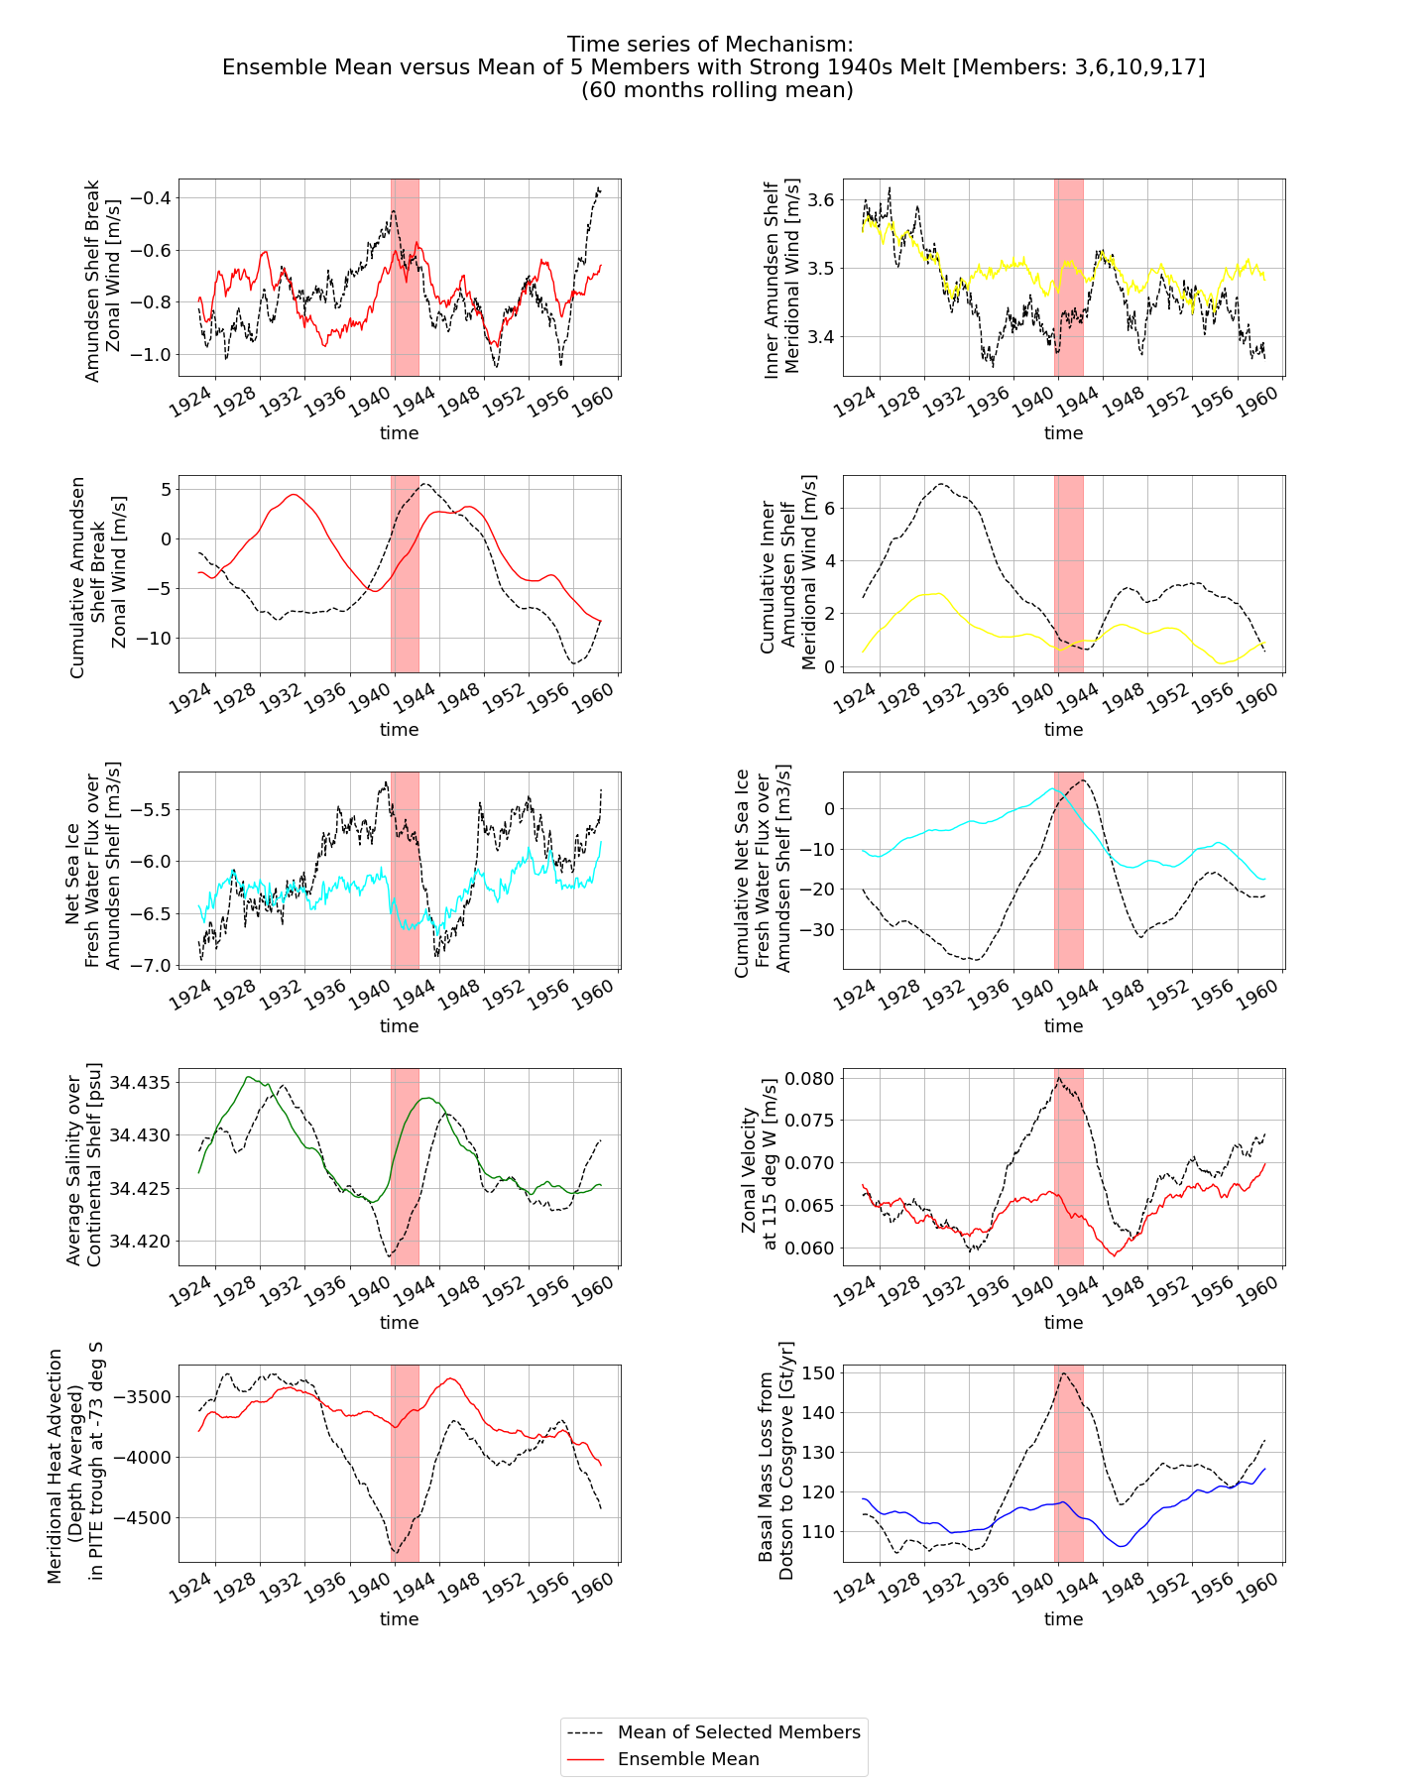

Slide 13
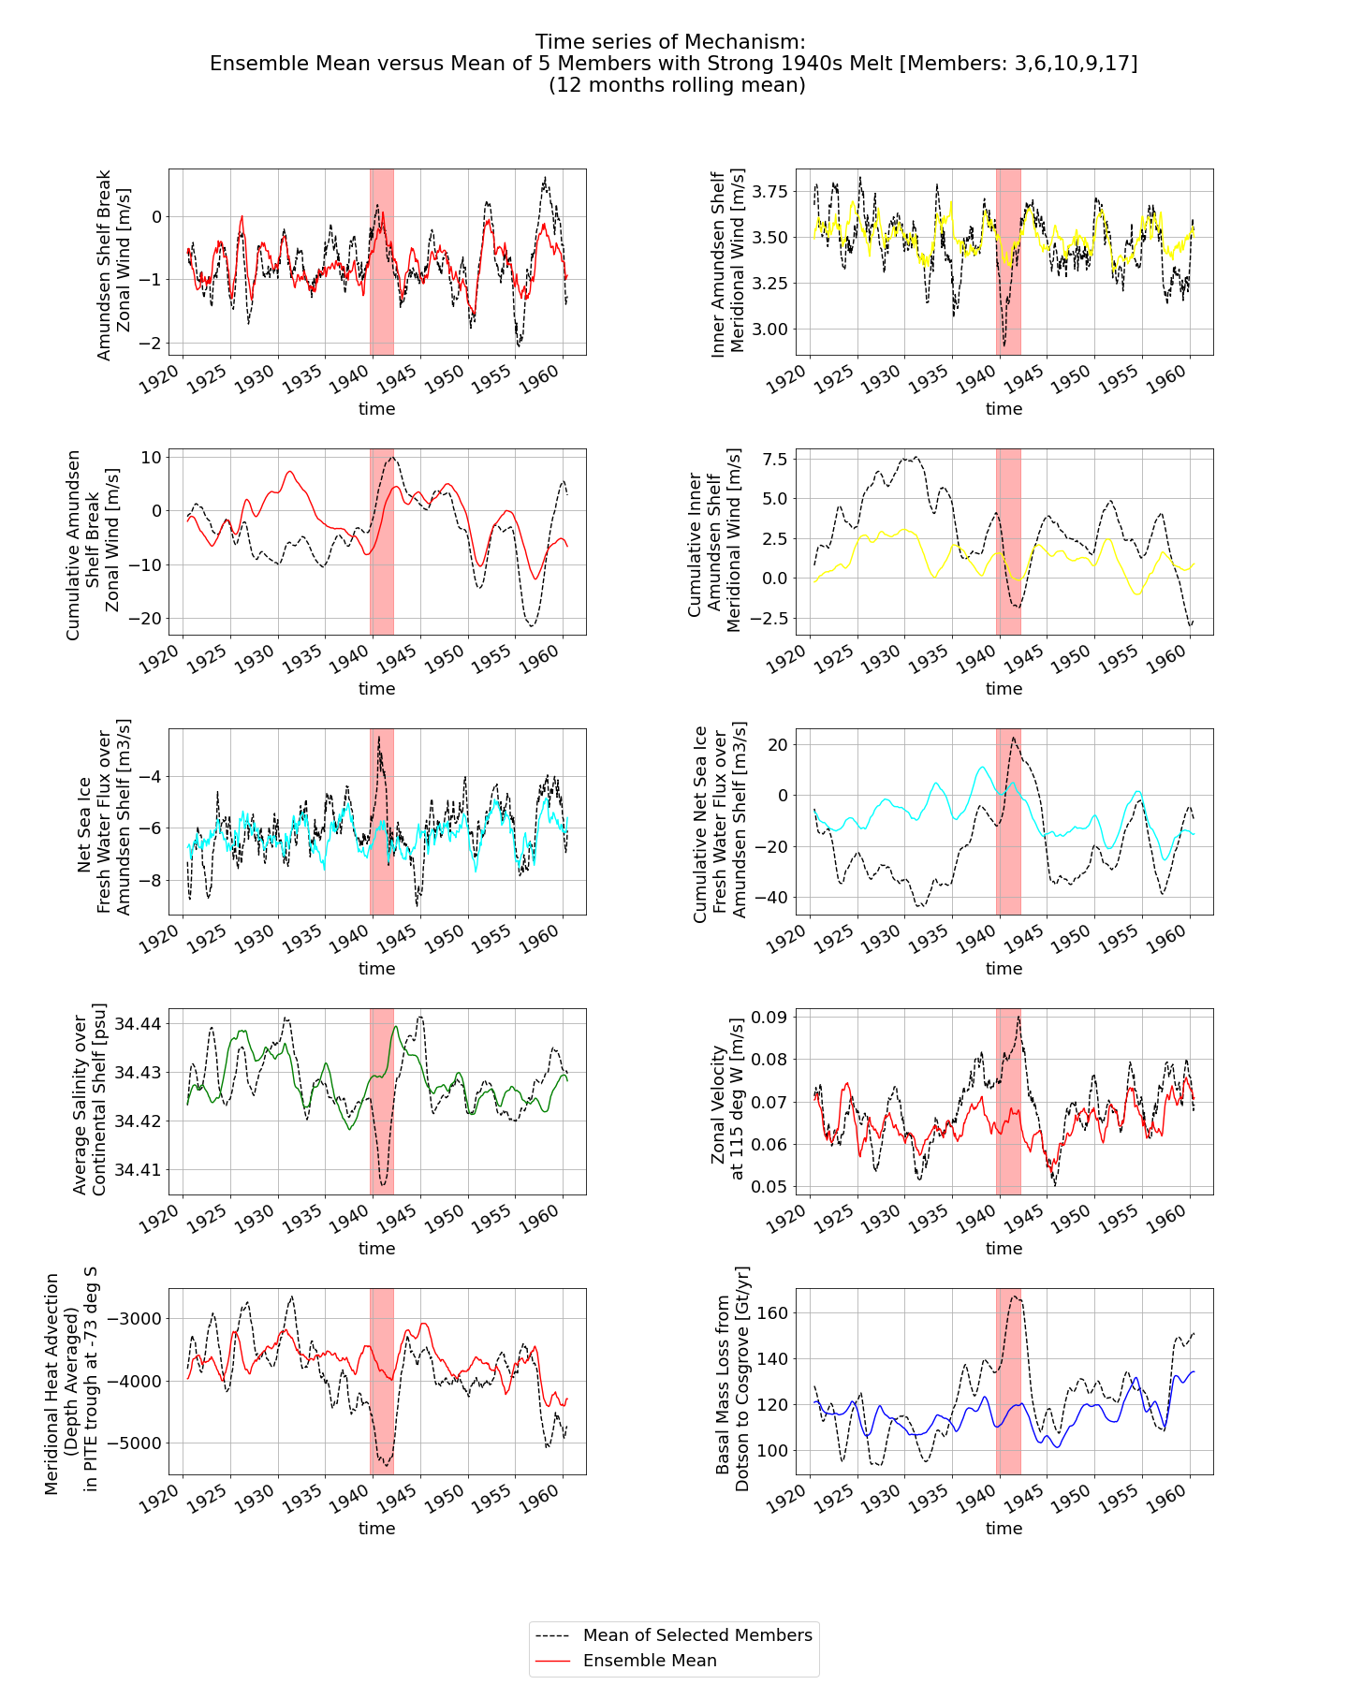

Slide 15
Lag of Correlation Maps

Slide 16
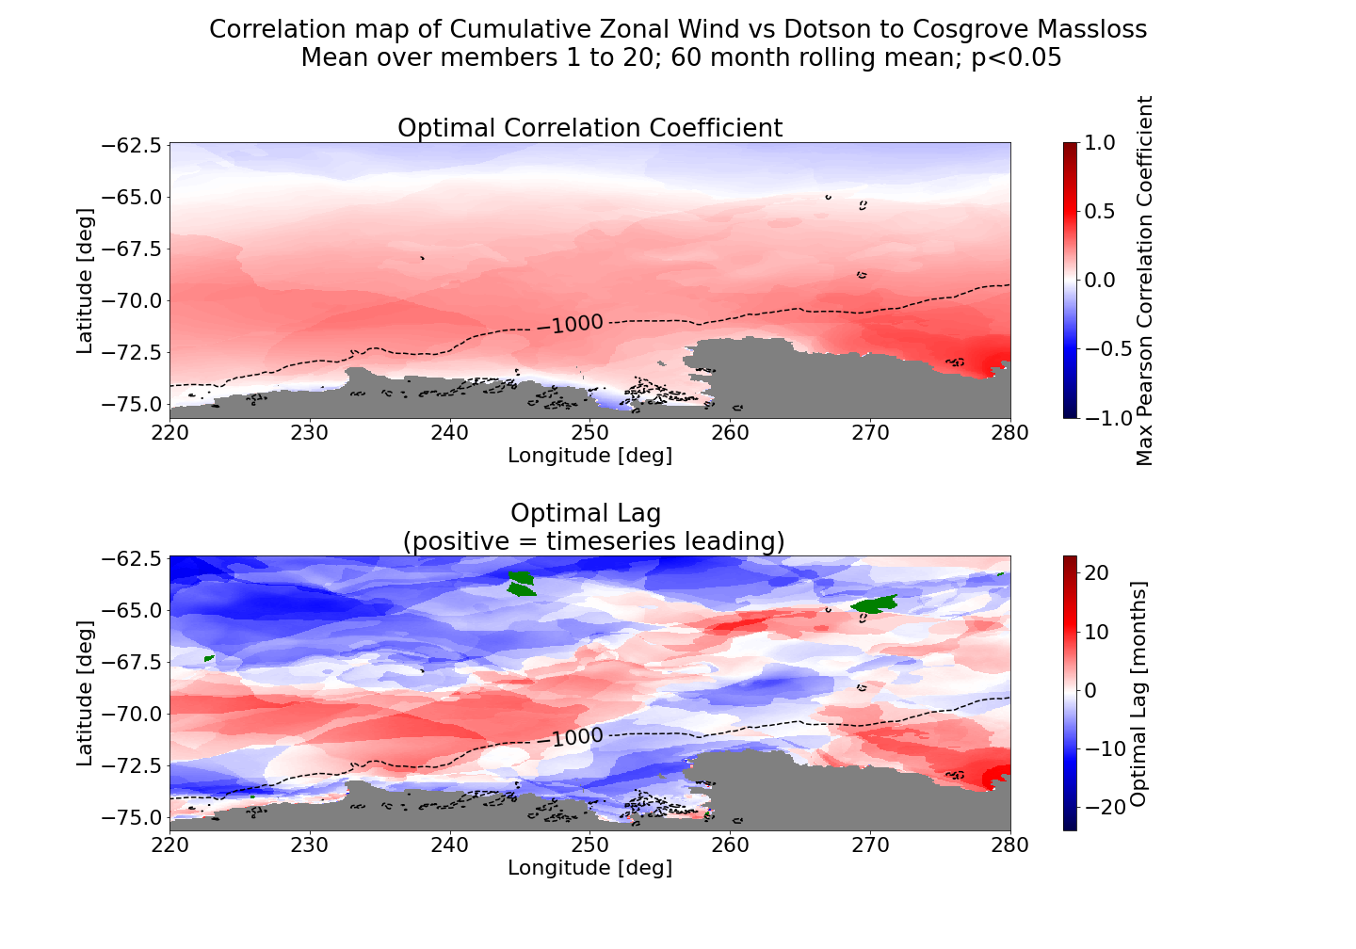

Slide 17
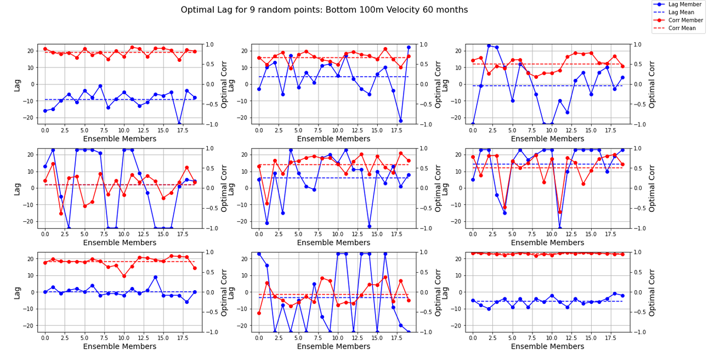

Slide 18
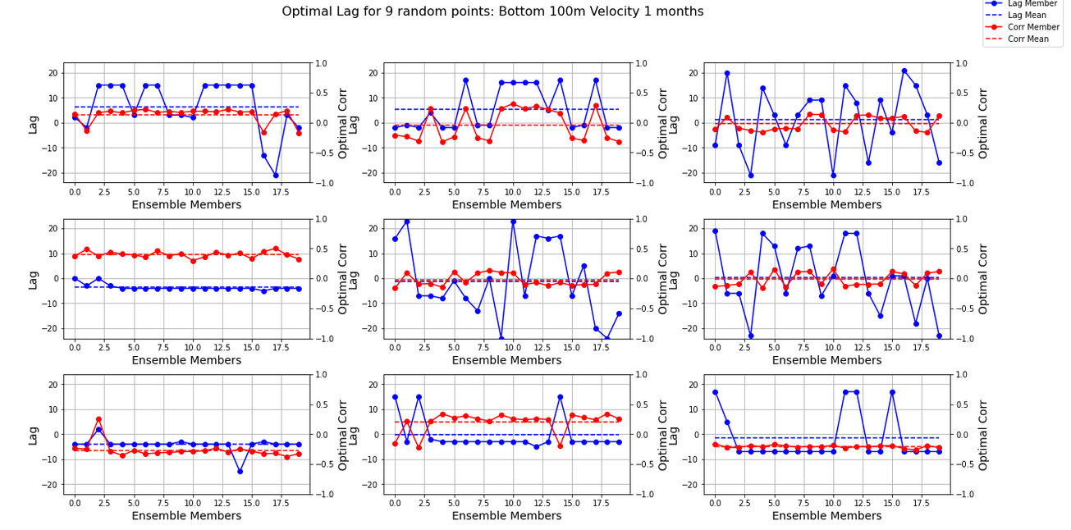

Slide 19
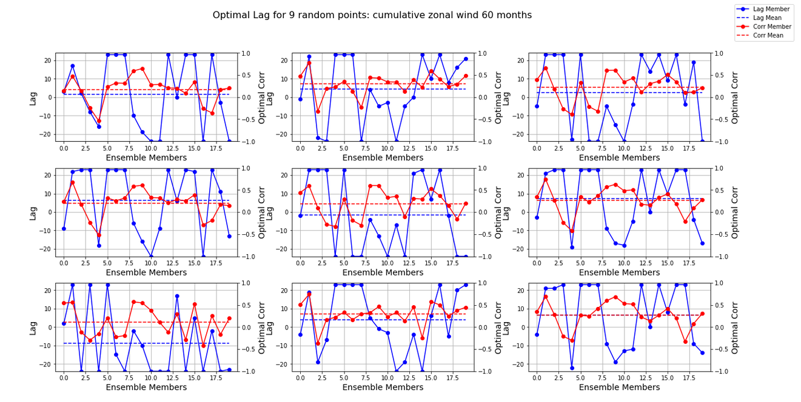

Slide 20
Solution
Pick modes?
Only show lag if standard deviation is less than 5 months?
Don’t show it and don’t take any information from it?
Run winds again only when it is leading melt.

Slide 21
Correlation Maps Surface Freshwater Flux

Slide 22
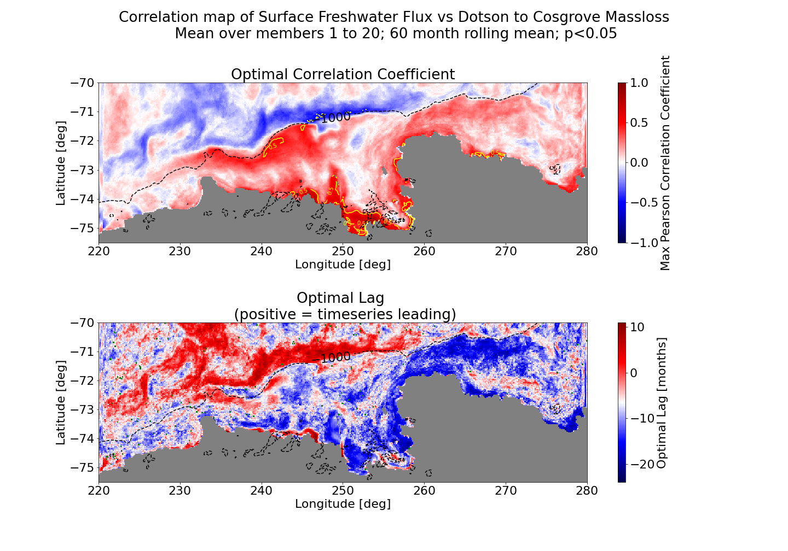

Slide 23
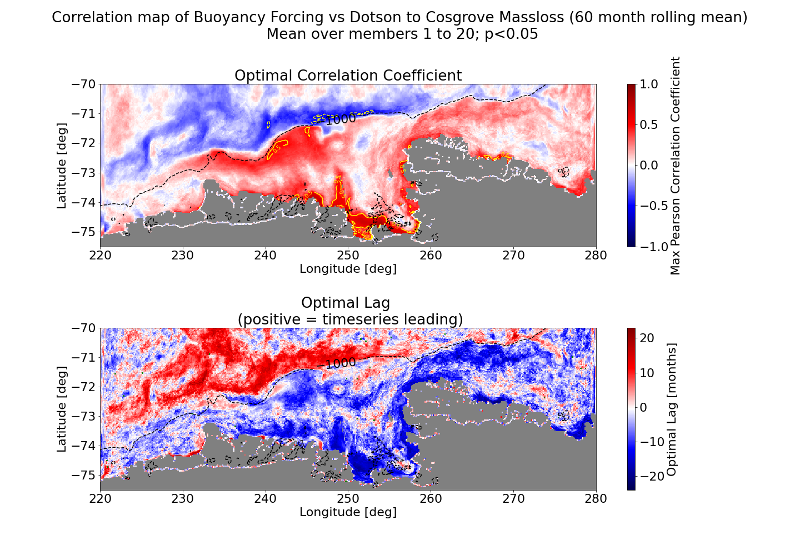

Slide 24
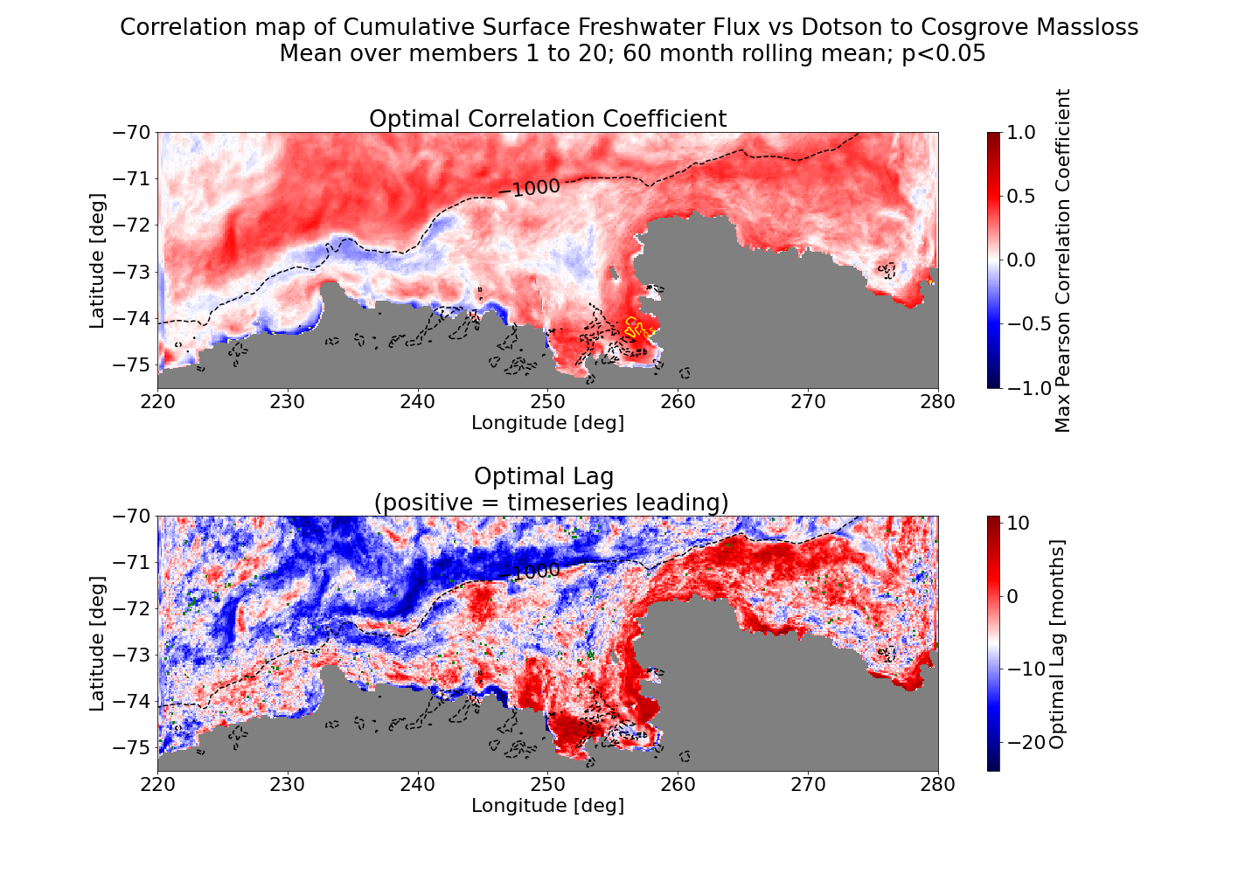

Slide 25
Next steps
Why is it direct and not cumulative?
Still in agreement with mechanism
Sea Ice Formation and Melt

Slide 26
“Pierre’s suspicion”: Baroclinic activity on short time scales

Slide 27
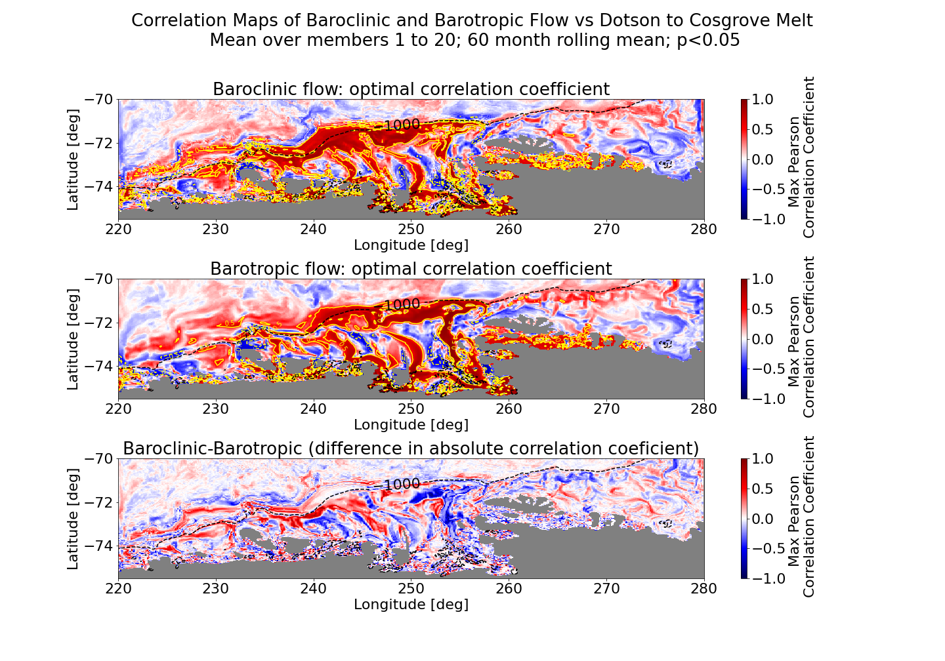

Slide 28
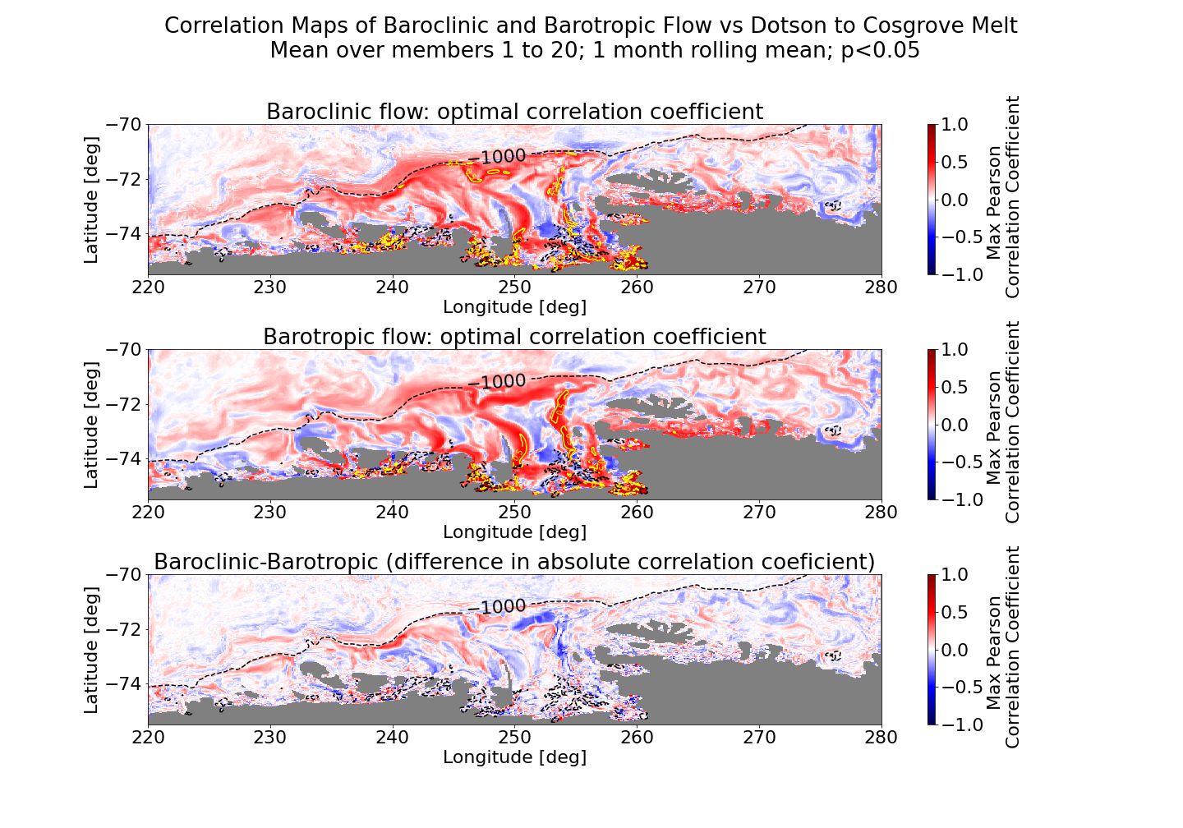

Slide 29
New Geometry

Slide 30
